Slide 1
CS 4032 – Web Programming
Dr. Hassan Sartaj

Slide 3
React
A JavaScript library created by Jordan Walke at Facebook
React allows creation of reusable UI components or user interfaces.
It is an open-source, component-based front end library which is responsible only for the view layer of the application
React is used to build single page applications.
Moved beyond the web into other environments like mobile apps and VR
Spawned a host of other libraries and frameworks known as the React Stack or React and Friends
Latest Version of React.JS is V18 (March 2022).

Slide 4
React is "V" in "MVC"
React is often used as the View in a Model View Controller architecture.
It provide an efficient way to update the DOM in response to state changes
As it only re-renders things that have changed, rather than just re-rendering everything

Slide 5
Manipulate An HTML Document
<html> <head><title>JavaScript Example</title></head>
<body>
<h1>JavaScript Example</h1>
<p>Some content.</p>
</body>
</html>
As a text file – very difficult
As an object

Slide 6
Document Object Model (DOM)
document
<html>
<head>
<body>
<title>
<h1>
<p>
“JavaScript Example”
“JavaScript Example”
“Some content.”
Common terminology: parent, child, sibling, ancestor, descendant

Slide 7
How does React Work
React creates a VIRTUAL DOM in memory.
Instead of manipulating the browser's DOM directly, React creates a virtual DOM in memory, where it does all the necessary manipulating, before making the changes in the browser DOM.
React finds out what changes have been made, and change only what needs to be changed.
A reconciliation process reflects the changes in virtual DOM in the real DOM

Slide 8
Why React JS
The main objective of React is to develop User Interfaces (UI) that improves the speed of the apps.
It uses virtual DOM (JavaScript object), which improves the performance of the app.
The JavaScript virtual DOM is faster than the regular DOM.
We can use React JS on the client and server-side as well as with other frameworks.
It uses component and data patterns that improve readability and helps to maintain larger apps.

Slide 9
React Features
The important features of React are as following.
JSX - JavaScript Extension (Its an XML or HTML like syntax)
Components
One-way Data Binding
Virtual DOM
Simplicity
Performance
Notes:
Component – Components are the basic building blocks of React. A React application is just a tree of components, each representing a different part of the DOM
One-way Data Binding : follows unidirectional data flow or one-way data binding to give better control throughout the application.
Simplicity : ReactJS uses JSX file which makes the application simple and to code as well as understand. We know that ReactJS is a component-based approach which makes the code reusable as your need. This makes it simple to use and learn.
Performance: The reason behind this is that it manages a virtual DOM. The DOM is a cross-platform and programming API which deals with HTML, XML or XHTML. The DOM exists entirely in memory. Due to this, when we create a component, we did not write directly to the DOM. Instead, we are writing virtual components that will turn into the DOM leading to smoother and faster performance.

Slide 10
Technical requirements
Once Node.js is installed, you can run below command to install react
npm install -g create-react-app
To create a new react App, run below command
npx create-react-app test_app
After successful creation of react app, below commands will be displayed.
npm start - This command will start the development server.
npm run build - Bundles the app into static files for production.
npm test - starts the test runner.
npm run object - Removes this tool and copies build dependencies, configuration files, and scripts into the app directory. If you do this, you can’t go back!
Now you need to start the development server for react by using command
npm start

Slide 11
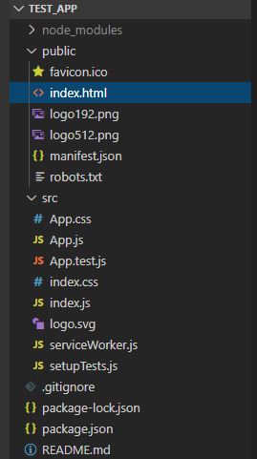
Folder Structure
For the project to build, these files must exist with exact filenames:
public/index.html is the page template;
src/index.js is the JavaScript entry point.

Slide 12
Basic App Structure
<div id="root"></div>
index.html
Bundled scripts added by
the build process
index.js
Loads the React libraries and
renders the App component
App.js
The App component

Slide 13
React Directly in HTML
The quickest way start learning React is to write React directly in your HTML files.
<html>
<script src="https://unpkg.com/react@16/umd/react.production.min.js"></script>
<script src="https://unpkg.com/react-dom@16/umd/react-dom.production.min.js"></script>
<script src="https://unpkg.com/babel-standalone@6.15.0/babel.min.js"></script>
<body>
<div id="mydiv"></div>
<script type="text/babel">
class Hello extends React.Component {
render() {
return <h1>Hello World!</h1>
}
}
ReactDOM.render(<Hello />, document.getElementById('mydiv'))
</script>
</body>
</html>
Notes:
Using Jsx syntax, We can render react directly in the html.

Slide 14
Render HTML - React v17
React's goal is in many ways to render HTML in a web page.
React renders HTML to the web page by using a function called ReactDOM.render().
Example
Display a paragraph inside the "root" element:
ReactDOM.render(<p>Hello</p>, document.getElementById('root'));
Index.Js
<body>
<div id="root"></div>
</body>
Index.html

Slide 15
Render HTML - React v18
In Index.js, update ReactDOM.render to ReactDOM.createRoot to create a root, and render your app using root.
Example
Display a paragraph inside the "root" element:
const container = document.getElementById(‘root’);
// create a root
const root = ReactDOM.createRoot(container);
//render app to root
root.render(<p>Hello</p>);
Index.Js
<body>
<div id="root"></div>
</body>
Index.html

Slide 16
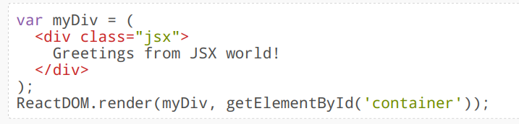
JSX
JSX => JavaScript XML.
JSX makes it easier to write and add HTML in React.
JSX is an extension of the JavaScript language based on ES6, and is translated into regular JavaScript at runtime.
JSX converts HTML tags into react elements.
JSX uses HTML syntax to create elements and components. It is just like a templating syntax. It has the tag name, attributes, and children.
JSX compiles the code into pure JavaScript which can be understood by the browser.
Notes:
React use Jsx - JSX is a JavaScript XML used in React applications. JSX is not compulsory to use in React applications but it makes your code more readable, reliable, and easy to modify. JSX is an extension to JavaScript.

Slide 17

JSX- Example
const myelement = <h1>I Love JSX!</h1>;
ReactDOM.render(myelement, document.getElementById('root'));
Expressions in JSX
With JSX you can write expressions inside curly braces { }.
The expression can be a React variable, or property, or any other valid JavaScript expression. JSX will execute the expression and return the result:
const myelement = <h1>React is {5 + 5} times better with JSX</h1>;
ReactDOM.render(myelement, document.getElementById('root'));
Notes:
in the first example, JSX allows us to write HTML directly within the JavaScript code.

Slide 18
JSX – Display List
To write HTML on multiple lines, put the HTML inside parentheses:
const myelement = (
<ul>
<li>Apples</li>
<li>Bananas</li>
<li>Cherries</li>
</ul>
);
ReactDOM.render(myelement, document.getElementById('root'));
Notes:
This code will display a list of fruits on the screen

Slide 19
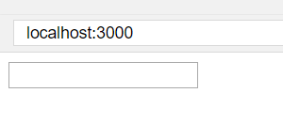
JSX –Display an input field
const myelement = <input type="text" />;
ReactDOM.render(myelement, document.getElementById('root'));
Notes:
This code will display a text box on the screen using JSX,
Similarly, we can create table as an element. And pass it as an element to ReactDOM.render().

Slide 20
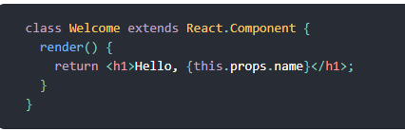
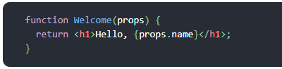
React Components
Components let you split the UI into independent, reusable pieces, and think about each piece in isolation.
They serve the same purpose as JavaScript functions, but work in isolation and returns HTML via a render function.
Conceptually, components are like JavaScript functions. They accept arbitrary inputs (called “props”) and return React elements describing what should appear on the screen.
Example -
Notes:
Components are like functions that return HTML elements.
Components make the task of building UIs much easier. You can see a UI broken down into multiple individual pieces called components and work on them independently and merge them all in a parent component which will be your final UI.
The above two components(shown as an example) are equivalent from React’s point of view.

Slide 21
Props
React allows to pass information/Data to a Component using something called props (stands for properties).
Props are arguments passed into React components via HTML attributes.
React Props are like function arguments in JavaScript and attributes in HTML.
Props flow downwards from the parent component this is why people refer to React as having uni-directional data flow.
In other words. Components receive data from the parent
Props are immutable, i.e., the value for properties cannot be changed.
It gives a way to pass data from one component to other components.
Notes:
React allows us to pass information to a Component using something called props (stands for properties).Props are basically kind of global variable or object
.

Slide 22
Props -Example
import React from "react";
import ReactDOM from "react-dom";
function App() {
return <Greeting name=“Hamza" age={25} occupation="Software Developer" />;
}
function Greeting(props) {
return (
<p>
Hello! I'm {props.name}, a {props.age} years old {props.occupation}.
Pleased to meet you!
</p>
);
}
ReactDOM.render(<App />, document.getElementById("root"));

Slide 23
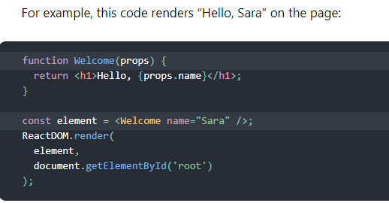
Component Types
There are 2 types of components in React.js
Functional Component
Class Component

Slide 24
Functional Component
Functional component includes simple JavaScript functions which takes props as an argument and returns a react element to be rendered on the page
=> Functional because they are basically functions
=> Can be Stateless or Stateful
=> Presentational because all they do is output UI elements
Notes:
Stateless Components are easy and fast to implement. They are good for very small UI view where re-render cost won’t matter that much. They provide cleaner code and less number of files to deal with.

Slide 25
Functional Component Examples

Slide 26
Class Component
Class components are created using ES6’s class syntax.
They are more complex than functional components including constructors, life-cycle methods, render( ) function and state (data) management.
=> Class because they are basically classes
=> Smart because they can contain logic
=> Stateful because they can hold and/or manage local state
=> Container because they usually hold/contain numerous other (mostly functional) components
Notes:
Class Components gives a considerable increase in performance because it reduces the number of render operation in the application which is a huge win for complex UI and therefore advised to use if possible. Also, there will be cases where you want to use the lifecycle methods of Component and in such cases, we cannot use stateless components.

Slide 27
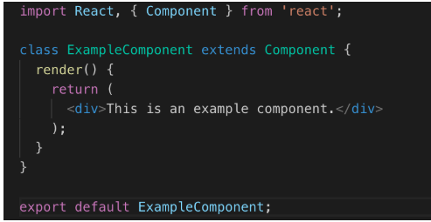
Class Component Example

Slide 28
Class Component with Props -Example
App.js
import React, { Component } from 'react';
class App extends React.Component {
render() {
return (
<div>
<h1> Welcome to { this.props.name } </h1>
</div>
);
}
}
export default App;
import React from 'react';
import ReactDOM from 'react-dom';
import App from './App.js';
ReactDOM.render(
<App name = “WebProgrammingt!!" />, document.getElementById('app'));
Notes:
When you need immutable data in the component, you have to add props to reactDom.render() method in the main.js file of your ReactJS project and used it inside the component in which you need.
Output will display “Welcome to web Programming”

Slide 29
Class Component with Constructor
If component has a constructor, the props should always be passed to the constructor and also to the React. Component via the super() method.
class Car extends React.Component {
constructor(props) {
super(props);
}
render() {
return <h2>I am a Car!</h2>;
}
}
ReactDOM.render(myelement, document.getElementById('root'));

Slide 30
How do I choose which component type to use?
Use a class component if you:
=> need to manage local state
=> need to add lifecycle methods to your component
=> need to add logic for event handlers
=> want to use lifecycle methods of Component
Notes:
When to use Class Components- Example
Suppose you creating a dictionary page in which you display the meaning of all the English words starting with A. Now you can write a component which takes a word and its meaning as props and return a proper view. And suppose you using pagination to display only 10 words at a time and on scroll asking for another 10 words and updating the state of the parent component. Class Components should be used in this case as it will avoid rendering of all the words which rendered in previous API request.
When to use functional Components
Suppose you want to create a label with some beautiful UI which will be used to rate the credibility of a profile like BEGINNER, MODERATE, EXPERT. Since its a very small component whose re-render will hardly make any difference and creating a new component for such a small case will be time-consuming.

Slide 31
State
React has another special built-in object called state
Allows components to create and manage their own data. So unlike props, components cannot pass data with state, but they can create and manage their state internally.
A change in the state happens based on user-input, triggering an event
React components (with state) are rendered based on the data in the state. State holds the initial information.

Slide 32
Change in State
When state changes, React gets informed and immediately re-renders the DOM – not the whole DOM, but only the component with the updated state. This is one of the reasons why React is fast.
React get notified on a state change with setState( ) method.
The setState( ) method triggers the re-rendering process for the updated parts. React gets informed, knows which part(s) to change, and does it quickly without re-rendering the whole DOM.

Slide 33
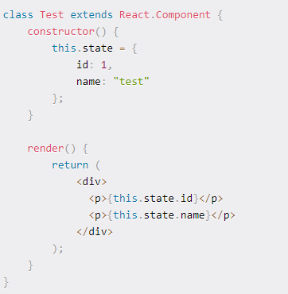
State Example
Notes:
State could only be used in class components, not in functional components.
That’s why functional components were also known as stateless components. However, after the introduction of React Hooks, state can now be used both in class and functional components.

Slide 34
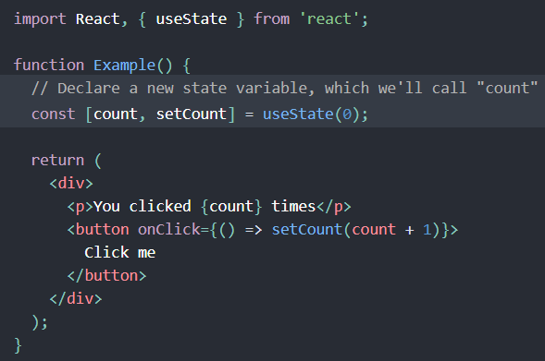
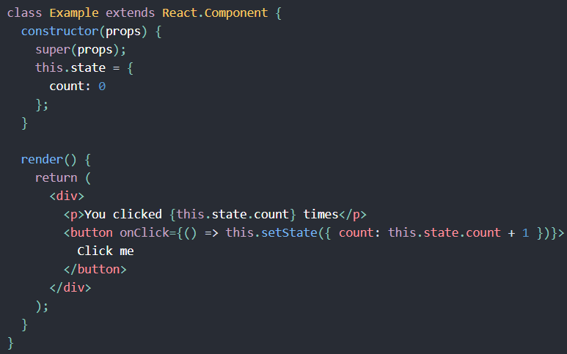
State Hook
A Hook is a special function that lets you “hook into” React features.
For example, useState() is a Hook that lets you add React state to function components.
If you write a function component and realize you need to add some state to it, previously you had to convert it to a class. Now you can use a Hook inside the existing function component.

Slide 35
React Component API
React component is a top-level API. It makes the code completely individual and reusable in the application.
It includes various methods for Creating elements Transforming elements and Fragments
Three most important methods available in the React component API.
setState()
forceUpdate()
findDOMNode() - ReactDOM.findDOMNode(component);
Notes:
setState()
This method is used to update the state of the component. This method does not always replace the state immediately. Instead, it only adds changes to the original state. It is a primary method that is used to update the user interface(UI) in response to event handlers and server responses.
forceUpdate()
This method allows us to update the component manually.
findDOMNode()
For DOM manipulation, you need to use ReactDOM.findDOMNode() method. This method allows us to find or access the underlying DOM node.
Reference - https://www.javatpoint.com/react-component-api

Slide 36
React Components Lifecycle
Each component in React has a lifecycle which you can monitor and manipulate during its three main phases.
The three phases are:
Mounting – Birth of your component
Update – Growth of your component
Unmount – Death of your component
Notes:
https://www.javatpoint.com/react-component-life-cycle

Slide 37
Component Lifecycle Methods
Mounting (invoked only once)
constructor()
render()
componentDidMount()
Updating
render()
componentDidUpdate()
Unmounting (invoked only once)
componentWillUnMount()

Slide 38
Mounting
Mounting means putting elements into the DOM.
React has four built-in methods that gets called, in this order, when mounting a component:
constructor() – called every time you make a component by React.
getDerivedStateFromProps() – The getDerivedStateFromProps() method is called right before rendering the element(s) in the DOM.
This is the natural place to set the state object based on the initial props.
It takes state as an argument, and returns an object with changes to the state.
render() - This is the method that actual outputs HTML to the DOM.
componentDidMount() - called after the component is rendered.
This is where you run statements that requires that the component is already placed in the DOM.
The render() method is required and will always be called, the others are optional and will be called if you define them.

Slide 39
Updating
The next phase in the lifecycle is when a component is updated. A component is updated whenever there is a change in the component's state or props.
React has five(5) built-in methods that gets called, in this order, when a component is updated:
getDerivedStateFromProps()
shouldComponentUpdate()
render()
getSnapshotBeforeUpdate()
componentDidUpdate()
The render() method is required and will always be called, the others are optional and will be called if you define them.
Notes:
1 .getDerivedStateFromProps() - Called when a component gets updated. This is still the natural place to set the state object based on the initial props.
2. shouldComponentUpdate() :specifies whether React should continue with the rendering or not and return a Boolean value.The default value is true.
3. Render()- The render() method is of course called when a component gets updated, it has to re-render the HTML to the DOM, with the new changes.
4- getSnapshotBeforeUpdate() : We can check what the values were before the update and we can access to the props and state.
5. componentDidUpdate

Slide 40
Unmounting
The next phase in the lifecycle is when a component is removed from the DOM, or unmounting as React likes to call it.
React has only one built-in method that gets called when a component is unmounted:
componentWillUnmount() - is called when the component is about to be removed from the DOM.

Slide 41
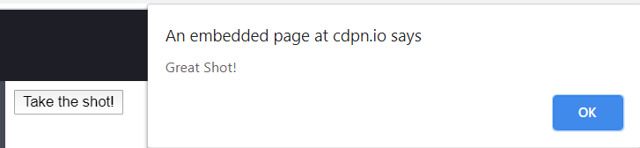
React Events
React can perform actions based on user events Just like HTML.
React has the same events as HTML: click, change, mouseover.
React events are written in camelCase syntax.
React event handlers are written inside curly{ } braces.
<button onClick={print}> Click me!</button>
import React from 'react';
import ReactDOM from 'react-dom';
function shoot() {
alert("Great Shot!");
}
const myelement = (
<button onClick={shoot}>Take the shot!</button>
);
ReactDOM.render(myelement, document.getElementById('root'));

Slide 42
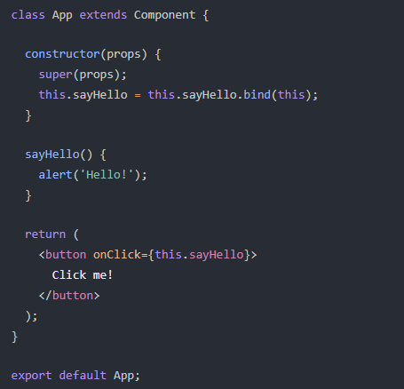
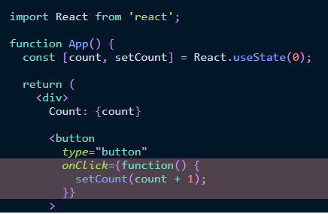
Event handler in Class component
Place the sayHello function inside the app component
onClick={this.sayHello}
Inline event handlers - Give us lots of new options by using an event handler directly in JSX:
Notes:
For methods in React, the this keyword should represent the component that owns the method.
If you must use regular functions instead of arrow functions ,you have to bind this to the component instance using the bind() method in the constructor as stated in above example

Slide 43
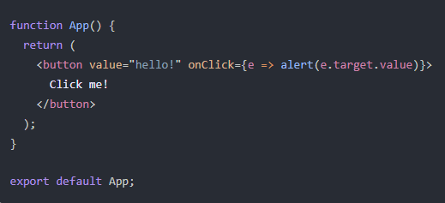
Synthetic Event
An object that contains useful metadata related to the event, such as the target element’s value
Example: Pass a Button Value to an Inline Function
The value e that’s returned from the onClick event handler:
Notes:
The code above accesses just that, the target element’s value, and shows it inside a browser alert. The e.target.value is originating from the value attribute that’s on the actual button element.

Slide 44
Arrow functions
Arrow functions are shorthand functions which automatically bind to the surrounding context.
A shorter syntax then typical JavaScript functions.
No binding of this keyword.
Normal Function
function funcName() {
// func body
}
funcName()
Arrow function
const funcName = () => {
// func body
}
funcName()
const square = (x) => x * x; console.log(square(21));
Notes:
You do not even write the return statement. It automatically returns the value. Refer to the above syntax

Slide 45
Arrow Vs Normal Functions
Arrow function do not have their own binding of this, so your this.setState refer to the YourClass.setState.
Using normal function, you need to bind it to the class to obtain Class's this reference. So when you call this.setState actually it refer to YourFunction.setState().
class FancyComponent extends Component {
handleChange(event) {
this.setState({ event }) // `this` is instance of handleChange
}
handleChange = (event) => {
this.setState({ event }) // `this` is instance of FancyComponent
}
}

Slide 46
Arrow functions and React Events
For methods in React, the this keyword should represent the component that owns the method.
That is why we should use arrow functions. With arrow functions, this will always represent the object that defined the arrow function.
Notes:
In class components, the this keyword is not defined by default, so with regular functions the this keyword represents the object that called the method, which can be the global window object, a HTML button, or whatever.

Slide 47
Events - Passing Arguments
Send parameters into an event handler, you have two options
Make an anonymous arrow function
Bind the event handler to this.
class Football extends React.Component {
shoot = (a) => {
alert(a);
}
render() {
return (
<button onClick={() => this.shoot("Goal")}>Take the shot!</button>
);
}
}
ReactDOM.render(<Football />, document.getElementById('root'));
class Football extends React.Component {
shoot(a) {
alert(a);
}
render() {
return (
<button onClick={this.shoot.bind(this, "Goal")}>Take the shot!</button>
);
}
}
ReactDOM.render(<Football />, document.getElementById('root'));
Notes:
https://www.w3schools.com/react/react_events.asp

Slide 48
React Forms
React offers a stateful, reactive approach to build a form to interact with user.
Rather than the DOM, Component usually handles the React form.
Form is usually implemented by using components.

Slide 49
Forms Are Special …
Form
Name:
John
this.state = { name: "John" };
<input type="text" value={this.state.name} />
React
DOM
state: { name: "John" }
input
value: "John"

Slide 50
… Forms Are Special
Form elements keep their internal states in DOM (e.g. value for <input>)
The data kind of goes from view → state instead of the state → view
React only allows one-way binding

Slide 51
Two Ways to Deal with Forms
Uncontrolled Components
Use ref to reference DOM elements and get their values
Controlled Components (recommended)
Handle onChange event
Set state in event handler
<input type="text"
onChange={ event => this.setState(
{name: event.target.value}) } />

Slide 52
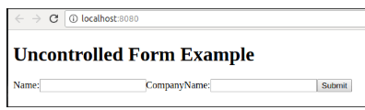
Uncontrolled component
DOM itself handles the form data.
HTML elements maintain their own state that will be updated when the input value changes.
Need to use a ref to the input field value from the DOM.
render() {
return (
<form onSubmit={this.updateSubmit}>
<h1>Uncontrolled Form Example</h1>
<label>Name:
<input type="text" ref={this.input} />
</label>
<label>
CompanyName:
<input type="text" ref={this.input} />
</label>
<input type="submit" value="Submit" />
</form>
);
} }
export default App;
import React, { Component } from 'react';
class App extends React.Component {
constructor(props) {
super(props);
this.updateSubmit = this.updateSubmit.bind(this);
this.input = React.createRef();
}
updateSubmit(event) {
alert('You have entered the UserName and CompanyName successfully.');
event.preventDefault();
}
Notes:
is similar to the traditional HTML form inputs
To write an uncontrolled component, you need to use a ref to get form values from the DOM. In other words, there is no need to write an event handler for every state update. You can use a ref to access the input field value of the form from the DOM.

Slide 53
Controlled Component
Form data is usually handled by the components.
All the data is stored in the component state and will be updated only with setState() method.
You can control changes by adding event handlers in the onChange attribute.
A controlled component takes its current value through props and notifies the changes through callbacks like an onChange event.

Slide 54
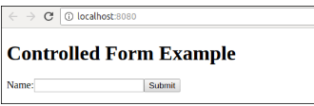
Controlled Component - Forms
import React, { Component } from 'react';
class App extends React.Component {
constructor(props) {
super(props);
this.state = {value: ''};
this.handleChange = this.handleChange.bind(this);
this.handleSubmit = this.handleSubmit.bind(this);
}
handleChange(event) {
this.setState({value: event.target.value});
}
handleSubmit(event) {
alert('You have submitted the input successfully: ' + this.state.value);
event.preventDefault();
}
render() {
return (
<form onSubmit={this.handleSubmit}>
<h1>Controlled Form Example</h1>
<label>
Name:
<input type="text" value={this.state.value} onChange={this.handleChange} />
</label>
<input type="submit" value="Submit" />
</form>
);
}
}
export default App;
Notes:
https://www.w3schools.com/react/showreact.asp?filename=demo2_react_forms_multiple

Slide 55
React Conditional Rendering
We can create multiple components which encapsulate behavior that we need.
After that, we can render them depending on some conditions or the state of our application.
There is more than one way to do conditional rendering in React
if
ternary operator
logical && operator
switch case operator
Conditional Rendering with enums
Notes:
Consider an example of handling a login/logout button. The login and logout buttons will be separate components. If a user logged in, render the logout component to display the logout button. If a user not logged in, render the login component to display the login button. In React, this situation is called as conditional rendering.

Slide 56
Conditional Rendering - Example
class App extends Component{
constructor(props)
{
super(props);
this.handleLogin = this.handleLogin.bind(this);
this.handleLogout = this.handleLogout.bind(this);
this.state = {isLoggedIn : false};
}
handleLogin()
{ this.setState({isLoggedIn : true});}
handleLogout()
{ this.setState({isLoggedIn : false});}
render(){
return(
<div>
<h1> Conditional Rendering Example </h1>
<Message isLoggedIn = {this.state.isLoggedIn}/> {
(this.state.isLoggedIn)?(
<Logout clickInfo = {this.handleLogout} />
) : (
<Login clickInfo = {this.handleLogin} /> )}
</div> ); } }
export default App;
import React, { Component } from 'react';
// Message Component
function Message(props)
{
if (props.isLoggedIn)
return <h1>Welcome Back!!!</h1>;
else
return <h1>Please Login First!!!</h1>;
}
// Login Component
function Login(props)
{ return(
<button onClick = {props.clickInfo}> Login </button>
); }
// Logout Component
function Logout(props)
{
return(
<button onClick = {props.clickInfo}> Logout </button> ); }
Notes:
In this example, we have created a stateful component called App which maintains the login control.
Here, we create three components representing Logout, Login, and Message component.
The stateful component App will render either or depending on its current state.

Slide 57
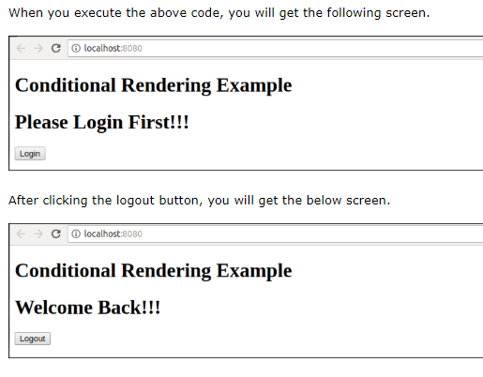
Output
Notes:
Here is output of below example

Slide 58
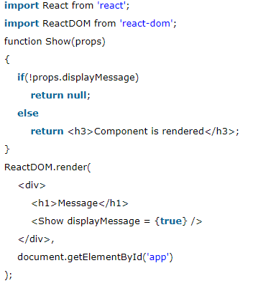
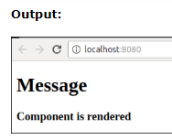
Preventing Component form Rendering
Sometimes it might happen that a component hides itself even though another component rendered it.
To do this (prevent a component from rendering), we will have to return null instead of its render output
Notes:
In this example, the is rendered based on the value of the prop called displayMessage. If the prop value is false, then the component does not render.

Slide 59
React Lists
The map() function is used for traversing the lists.
In the below example, the map() function takes an array of numbers and multiply their values with 5
We assign the new array returned by map() to the variable multiplyNums and log it.
var numbers = [1, 2, 3, 4, 5];
const multiplyNums = numbers.map((number)=>{
return (number * 5);
});
console.log(multiplyNums);

Slide 60
React Keys
Keys React are utilized to identify specific Virtual DOM Elements that have changed.
const FruitList = (props) =>{ const fruits = props.fruits.map((fruit) => <li>{fruit.name}</li> ) return( <ul> {fruits} </ul> ) }
const FruitList = (props) =>{ const fruits = props.fruits.map((fruit) => <li key={fruit.id}>{fruit.name}</li> ) return( <ul> {fruits} </ul> ) }
Notes:
A – Without key, This works and does indeed render the list of fruits.
However at any moment we might want to add new fruits, as well as delete or modify the existing ones. How would React know to perform those changes efficiently? That’s where the key attribute comes in handy. There are usually several choices for creating element’s unique identity. One of them is using existing IDs of each object:

Slide 61
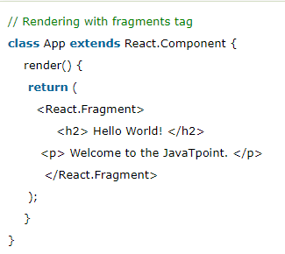
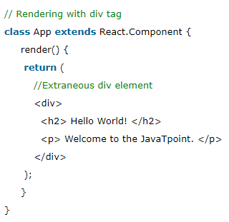
React Fragments
Fragments allow you to group a list of children without adding extra nodes to the DOM.
The render method will require a 'div' tag and put the entire content or elements inside it.
It makes the execution of code faster as compared to the div tag and takes less memory.
Notes:
Replace div with <React.Fragment> in render method.
we can use of '<>' and '' instead of the 'React.Fragment'.

Slide 62
The Need for Routing
Usually we have different pages in a web application
How do we have different "pages" in a SPA?
Home
About
Login

Slide 63
Routing
Load different components based on different URL
About
Component
Home
About
Login
Login
Component
Home Component
App Component

Slide 64
React Router
Routing is a process in which a user is directed to different pages based on their action or request.
React Router is the standard routing library for React. It keeps your UI in sync with the URL.
When a user types a specific URL into the browser, and if this URL path matches any 'route' inside the router file, the user will be redirected to that particular route.
Need to install react router by using this command:
npm install react-router-dom --save

Slide 65
Basic Usage of React Router …
<Router>
<React.Fragment>
<ul>
<li><Link to="/">Home</Link></li>
<li><Link to="/about">About</Link></li>
</ul>
<Routes>
<Route path="/" exact element={<Home />}> </Route>
<Route path=“about" element={< About />}> </Route>
</Routes>
</React.Fragment>
</Router>

Slide 66
… Basic Usage of React Router
<Router> aliased as BrowserRouter component listens to URL changes and loads/unloads components. BrowserRouter wraps all your Route components.
<Route> maps a path to a component
exact matches the full path instead of just the prefix
responsible for showing - or hiding - the components they contain.
<Link> replaces <a> so the requests do not go back to the server
as you can imagine - used to generate links to your routes

Slide 67
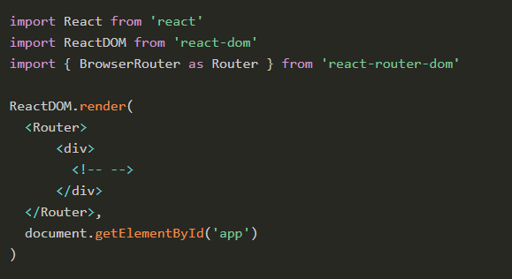
BrowserRouter
Import BrowserRouter from react-router-dom, and you use it to wrap all your app:
A BrowserRouter component can only have one child element, so we wrap all we’re going to add in a div element.
Notes:
Here’s a simple example of the BrowserRouter component

Slide 68
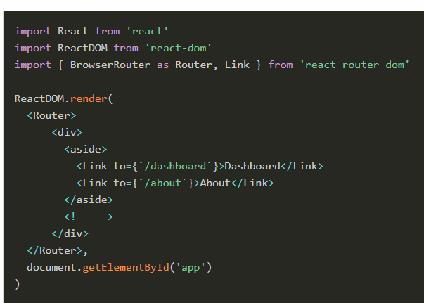
Link
The Link component is used to trigger new routes.
Import it from react-router-dom, and you can add the Link components to point at different routes, with the to attribute.

Slide 69
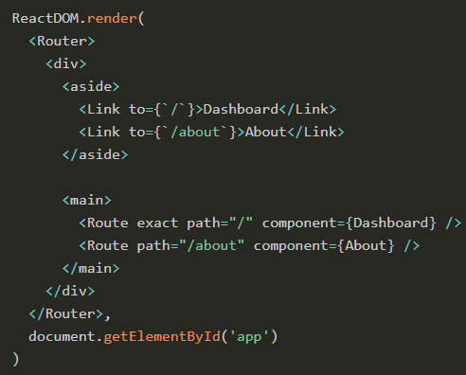
Router
Now let’s add the Route component in the above snippet to make things actually work as we want:
import React from 'react'
import ReactDOM from 'react-dom'
import { BrowserRouter as Router, Link, Route } from 'react-router-dom'
const Dashboard = () => (
<div>
<h2>Dashboard</h2>
...
</div>
)
const About = () => (
<div>
<h2>About</h2>
...
</div>
)
Notes:
When the route matches /, the application shows the Dashboard component.
When the route is changed by clicking the “About” link to /about, the Dashboard component is removed and the About component is inserted in the DOM.
Notice the exact attribute. Without this, path="/" would also match /about, since / is contained in the route.
Check this example on Glitch: https://flaviocopes-react-router-v4.glitch.me/

Slide 70
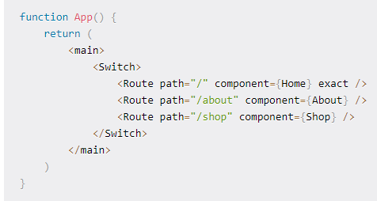
React Router Switch
The <Switch> component is used to render components only when the path will be matched. Otherwise, it returns to the not found component.
Notes:
Add the Switch element (open and closing tags). These ensure that only one component is rendered at a time. If we don't use this, we can default to the Error component, which we're going to write later

Slide 71
Other React Router Components
<BrowserRouter> vs <HashRouter>
BrowserRouter relies on HTML 5 History API which may not be available on older browsers
BrowserRouter also relies on the web server configured to serve index.html regardless of the path
HashRouter has # in URLs which is aesthetically unpleasing
<Link> vs <NavLink>
NavLink allow more styling (e.g. activated link)
<Switch> renders the first matched <Route> in its children

Slide 72
Components in React Router
There are two types of router components:
<BrowserRouter>: It is used for handling the dynamic URL.
<HashRouter>: It is used for handling the static request.
<BrowserRouter> builds the classic URL as
< HashRouter> builds the URL with Hash
https://application.com/dashboard /* BrowserRouter */
https://application.com/#/dashboard /* HashRouter */

Slide 73
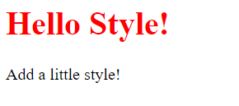
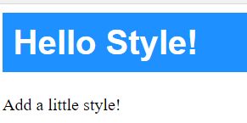
Styling React Using CSS
import React from 'react';
import ReactDOM from 'react-dom';
class MyHeader extends React.Component {
render() {
return (
<div>
<h1 style={{color: "red"}}>Hello Style!</h1>
<p>Add a little style!</p>
</div>
);
}
}
class MyHeader extends React.Component {
render() {
const mystyle = {
color: "white",
backgroundColor: "DodgerBlue",
padding: "10px",
fontFamily: "Arial"
};
return (
<div>
<h1 style={mystyle}>Hello Style!</h1>
<p>Add a little style!</p>
</div>
);
}
}

Slide 74
Example
Contact List -- Display Contacts from REST API

Slide 75
Example – Setting up bootstrap
// public/index.html ...
<head> ...
<link rel="stylesheet" href="https://stackpath.bootstrapcdn.com/bootstrap/4.1.3/css/bootstrap.min.css" integrity="sha384-MCw98/SFnGE8fJT3GXwEOngsV7Zt27NXFoaoApmYm81iuXoPkFOJwJ8ERdknLPMO" crossorigin="anonymous"> ...
</head>

Slide 76
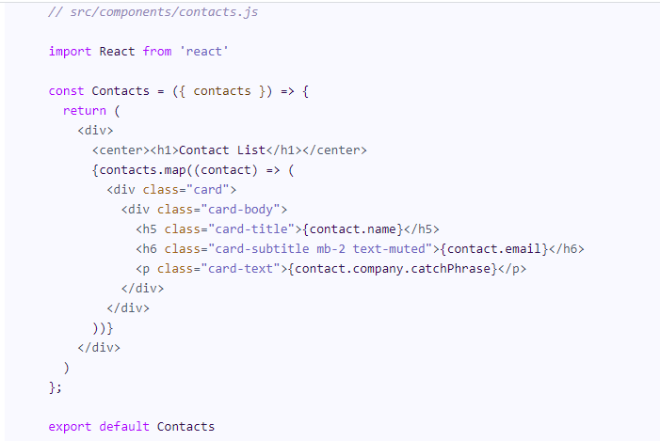
Example

Slide 77
Guest Book Example
My Guest Book
John says:
Hello!
Edit | Delete
Jane says:
Your website looks nice.
Edit | Delete
Joe says:
Nice to meet you. I’m from China.
Edit | Delete
Add Comment
Add Comment
Edit Entry
Your name:
Your name:
Jane
Your website looks nice.
Add
Save

Slide 78
Load Data from Server
When?
How?

Slide 79
Fetch vs Axios
Both are Promise-based
Fetch is a standard Web API
May not be available on older browsers
Available for React Native
Axios is a popular JavaScript HTTP client library
Treat error status codes as error so it can be handled in catch() instead of then()

Slide 80
Submit a Form
Handle the onSubmit event of the form, e.g.,
Prevent browser
from submitting
the form
<form onSubmit={
event => {
event.preventDefault();
axios.post("/api", {
this.state.name,
this.state.message
})
.then( ()=>history.push("/") );
}
}>
"Redirect" to /
Event handler
A hook provide by React Router

Slide 81
Keeping Data in SPA …
It's inefficient to query the server every time the GuestBook component is mounted
Maybe we want to keep a local copy of GuestBook in the SPA (the data may get stale but it's more efficient)

Slide 82
… Keeping Data in SPA
Where the data should be stored?
App
GuestBook
AddComment

Slide 83

Basic State Management in React
States stored in root component
Parent passes data down to children as properties
Parent also passes callback functions to children as properties, and children can use those callbacks to send changes back up

Slide 84
State Management Can Get Difficult and Messy

Slide 85
Store States in One Place

Slide 86
State Management Solutions
React Context API
Redux
More mature and performant
More features and tool support

Slide 87
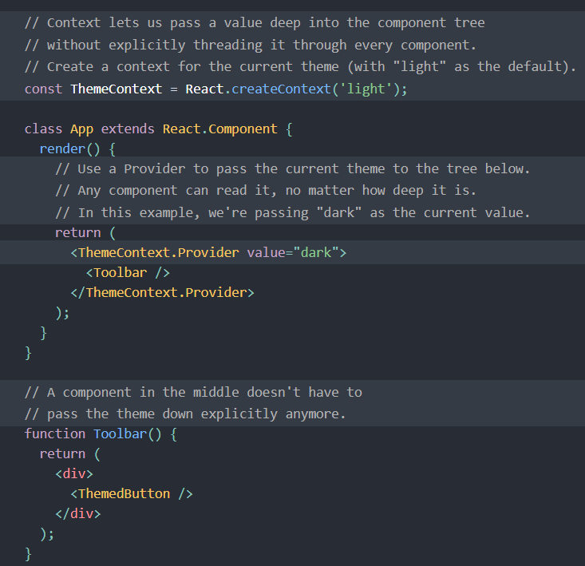
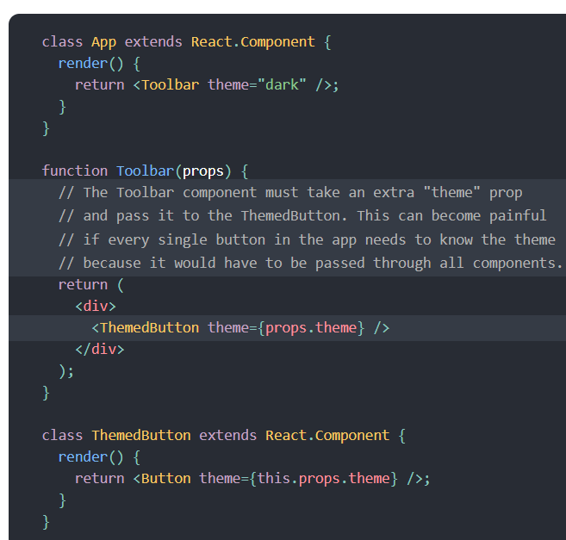
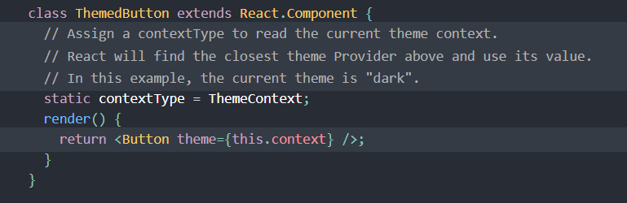
State Management React Context-Example

Slide 88
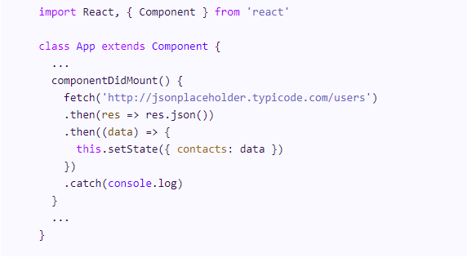
Call A RESTful API in React
fetch('http://jsonplaceholder.typicode.com/users') will make a GET request to the endpoint
.then(res => res.json()) parses the output to JSON,
.then((data) => {this.setState({ contacts: data })}) sets the value of our state to the output from the API call and finally .catch(console.log) logs any error we get to the console.

Slide 89
Example – App.js
class App extends Component {
state = {
contacts: []
}
componentDidMount() {
fetch('http://jsonplaceholder.typicode.com/users')
.then(res => res.json())
.then((data) => {
this.setState({ contacts: data })
})
.catch(console.log)
}
render() {
return (
<Contacts contacts={this.state.contacts} />
);}} export default App;

Slide 90
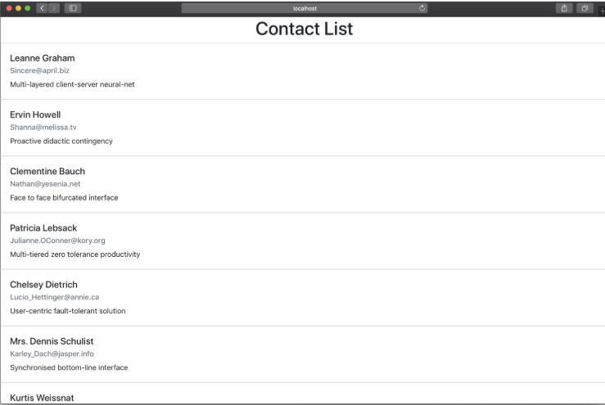
Example - Output

Slide 91
Some React Resources
React Bootstrap
React Icons
Awesome React Components
bit.dev for publishing, sharing, and searching components

Slide 92
Readings
React
React Router
Redux and React Redux

Slide 93
Thank you!

